Slide 1

Neural Networks
BI Tech Surgery | Nov 16th 2018 | Ankush Tale

Slide 2

Topics to cover
What is a Biological Neuron?
What is a Artificial Neuron?
A Perceptron
Example of a binary function
Activation Function
Loss function
Loss optimization methods
Example of classification using Neural Net
Acknowledgement:
Content from IITM CS7015 – Deep Learning by Prof. Mitesh Khapra
Notes:
Disclaimer for simplicity

Slide 3

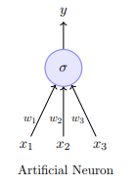
Artificial Neuron
Fundamental unit of a neural network
Inspired from biological Neurons

Slide 4
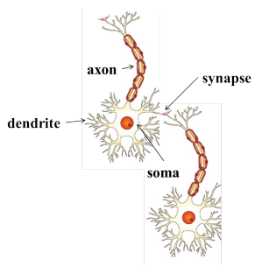
Biological Neuron
Neuron proposed 1891, Synapse in 1950
Dendrite: receives signals from other neurons
Synapse: point of connection to other neurons
Soma: processes the information
Axon: transmits the output of this neuron

Slide 5
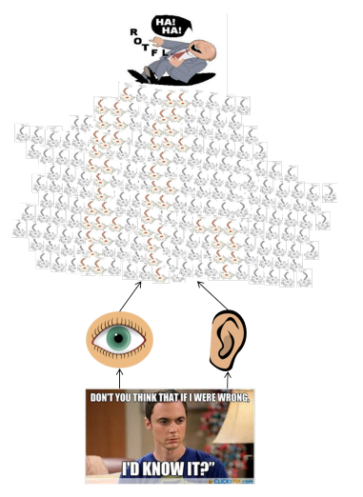
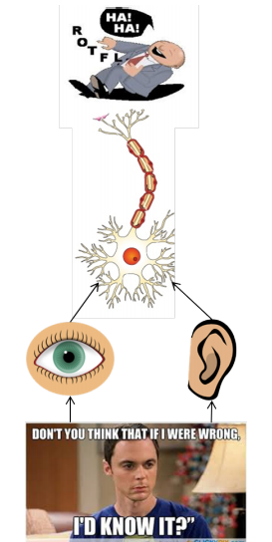
How do Neuron’s work
Our sense organs interact with the outside world
They relay information to the neurons
The neurons (may) get activated and produces a response
Of course in reality it is a massively parallel interconnected network of neurons
An average human brain has around 10¹¹ (100 billion) neurons!

Slide 6
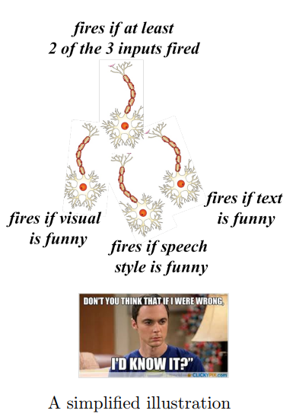
How do Neuron’s work
This massively parallel network also ensures that there is division of work
Each neuron may perform a certain role or respond to a certain stimulus

Slide 7
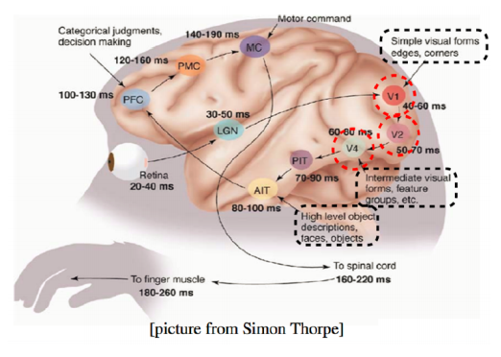

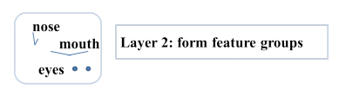
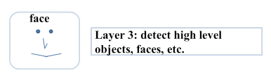
How do Neuron’s work

Slide 8
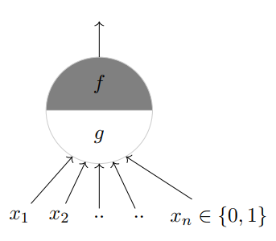

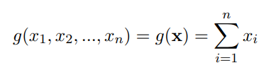
McCulloch & Pits Neuron
McCulloch (neuroscientist) and Pitts (logician) proposed a highly simplified computational model of the neuron (1943)
some number
Threshold/bias
Applies a function
Sums up inputs
Notes:
There’s a famous quote that says with every formula a presenter shows, he/she looses half his audience. Let me be brave enough to lose half of you.

Slide 9
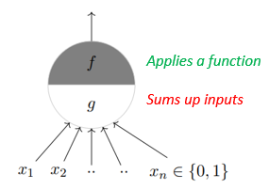
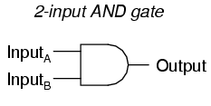
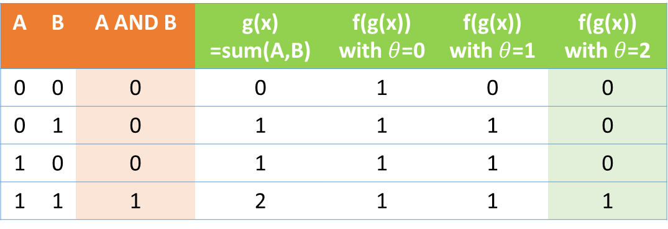
McCulloch & Pits Neuron
McCulloch (neuroscientist) and Pitts (logician) proposed a highly simplified computational model of the neuron (1943)
For 2 binary inputs,
We wish to build a Neuron
That gives output similar to AND
Threshold/bias=?
A | B | A AND B | g(x) =sum(A,B) | f(g(x)) with $θ$=0 | f(g(x)) with $θ$=1 | f(g(x)) with $θ$=2
0 | 0 | 0 | 0 | 1 | 0 | 0
0 | 1 | 0 | 1 | 1 | 1 | 0
1 | 0 | 0 | 1 | 1 | 1 | 0
1 | 1 | 1 | 2 | 1 | 1 | 1
Notes:
Remember the And function, you might have seen this in high school or college depending on if you went to CBSE or SSC

Slide 10
McCulloch & Pits Neuron
Threshold/bias=?
A | B | A AND B | g(x) =sum(A,B) | f(g(x)) with $θ$=0 | f(g(x)) with $θ$=1 | f(g(x)) with $θ$=2
0 | 0 | 0 | 0 | 1 | 0 | 0
0 | 1 | 0 | 1 | 1 | 1 | 0
1 | 0 | 0 | 1 | 1 | 1 | 0
1 | 1 | 1 | 2 | 1 | 1 | 1
Notes:
Remember the And function, you might have seen this in high school or college depending on if you went to CBSE or SSC

Slide 11
McCulloch & Pits Neuron
Threshold/bias=?
For different values of bias
A | B | A AND B | g(x) =sum(A,B) | f(g(x)) with $θ$=0 | f(g(x)) with $θ$=1 | f(g(x)) with $θ$=2
0 | 0 | 0 | 0 | 1 | 0 | 0
0 | 1 | 0 | 1 | 1 | 1 | 0
1 | 0 | 0 | 1 | 1 | 1 | 0
1 | 1 | 1 | 2 | 1 | 1 | 1
Notes:
Remember the And function, you might have seen this in high school or college depending on if you went to CBSE or SSC

Slide 12
McCulloch & Pits Neuron
To predict output same as AND,
Threshold/Bias = 2
Threshold/bias=2
A | B | A AND B | g(x) =sum(A,B) | f(g(x)) with $θ$=0 | f(g(x)) with $θ$=1 | f(g(x)) with $θ$=2
0 | 0 | 0 | 0 | 1 | 0 | 0
0 | 1 | 0 | 1 | 1 | 1 | 0
1 | 0 | 0 | 1 | 1 | 1 | 0
1 | 1 | 1 | 2 | 1 | 1 | 1
Notes:
Remember the And function, you might have seen this in high school or college depending on if you went to CBSE or SSC

Slide 13
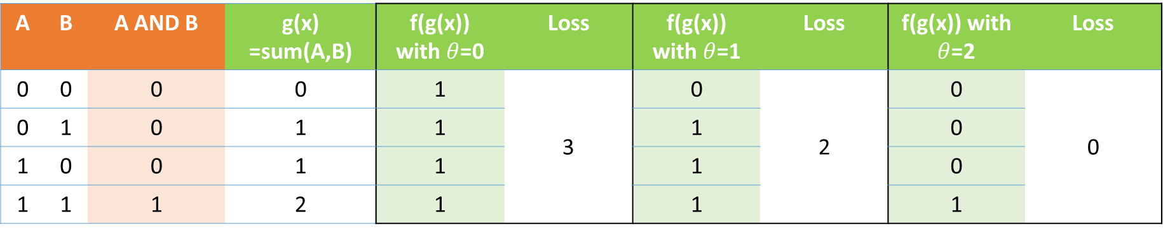
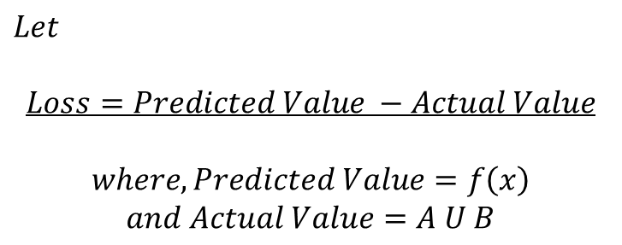
McCulloch & Pits Neuron
$$Let$$
$$Loss=Predicted Value −Actual Value$$
$$where, Predicted Value=f\left(x\right)$$
$$and Actual Value=A U B$$
A | B | A AND B | g(x) =sum(A,B) | f(g(x)) with $θ$=0 | Loss | f(g(x)) with $θ$=1 | Loss | f(g(x)) with $θ$=2 | Loss
0 | 0 | 0 | 0 | 1 | 3 | 0 | 2 | 0 | 0
0 | 1 | 0 | 1 | 1 |  | 1 |  | 0
1 | 0 | 0 | 1 | 1 |  | 1 |  | 0
1 | 1 | 1 | 2 | 1 |  | 1 |  | 1
Notes:
Remember the And function, you might have seen this in high school or college depending on if you went to CBSE or SSC

Slide 14
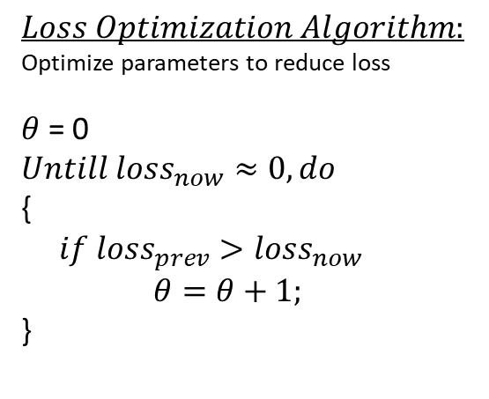
McCulloch & Pits Neuron
$$Loss Optimization Algorithm:$$
Optimize parameters to reduce loss
$θ$ = 0
$$Untill loss_{now}≈0, do$$
{
$if loss_{prev}>loss_{now}$
$θ=θ+1;$
}
A | B | A AND B | g(x) =sum(A,B) | f(g(x)) with $θ$=0 | Loss | f(g(x)) with $θ$=1 | Loss | f(g(x)) with $θ$=2 | Loss
0 | 0 | 0 | 0 | 1 | 3 | 0 | 2 | 0 | 0
0 | 1 | 0 | 1 | 1 |  | 1 |  | 0
1 | 0 | 0 | 1 | 1 |  | 1 |  | 0
1 | 1 | 1 | 2 | 1 |  | 1 |  | 1
Notes:
Remember the And function, you might have seen this in high school or college depending on if you went to CBSE or SSC

Slide 15

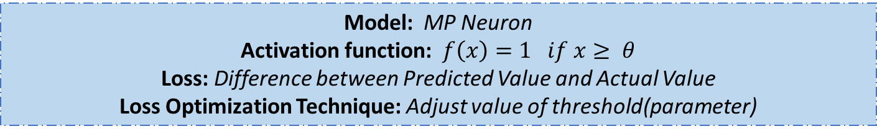
So, given an input, we need to find a function that fits the input.
This is what Machine Learning is all about ☺
Congratulations! You understood your very first ML model (proposed way back in 1943)
Model: MP Neuron
Activation function: $f\left(x\right)=1 if x≥ θ$
Loss: Difference between Predicted Value and Actual Value
Loss Optimization Technique: Adjust value of threshold(parameter)
Notes:
Timeline of evolution of algos in ML; everything you see today started after 2006; not exactly activation function but let’s go with it as of now.

Slide 16
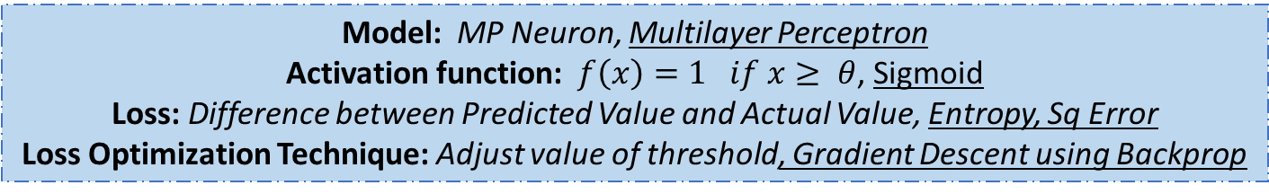
So, given an input, we need to find a function that fits the input.
This is what Machine Learning is all about ☺
Congratulations! You understood your very first ML model (proposed way back in 1943)
Model: MP Neuron, Multilayer Perceptron
Activation function: $f\left(x\right)=1 if x≥ θ$, Sigmoid
Loss: Difference between Predicted Value and Actual Value, Entropy, Sq Error
Loss Optimization Technique: Adjust value of threshold, Gradient Descent using Backprop
Notes:
We’ll cover these too today

Slide 17
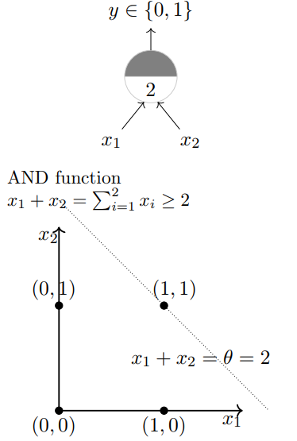
Visualize Boundary condition
Boundary condition is the point/line/plane beyond which your output changes i.e. from 0 to 1
Equation of line
Notes:
On case of OR

Slide 18
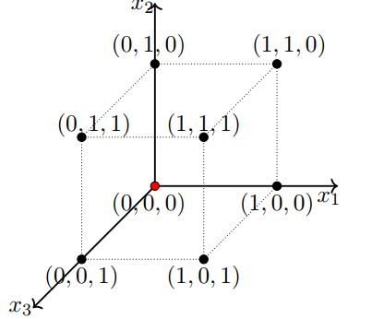
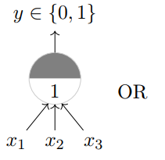
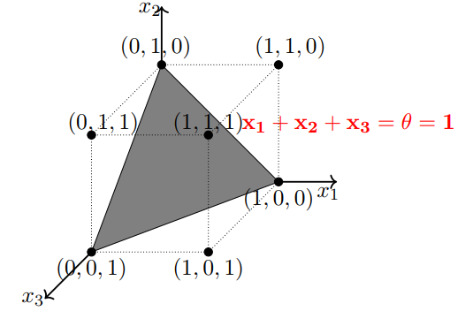
For 3 inputs
A | B | C | A AND B | g(x) =sum(A,B) | f(g(x)) with ʘ=3
0 | 0 | 0 | 0 | 0 | 0
0 | 0 | 1 | 0 | 1 | 0
0 | 1 | 0 | 0 | 1 | 0
0 | 1 | 1 | 0 | 2 | 0
1 | 0 | 0 | 0 | 1 | 0
1 | 0 | 1 | 0 | 2 | 0
1 | 1 | 0 | 0 | 2 | 0
1 | 1 | 1 | 1 | 3 | 1

Slide 19
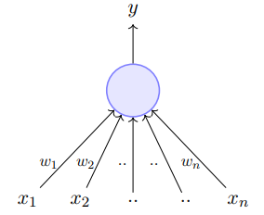
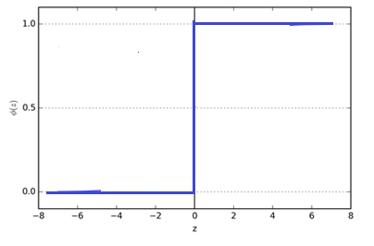
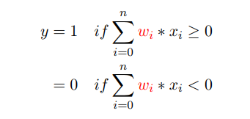
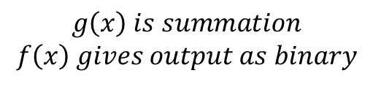
Perceptron
f
g
For non-Boolean, real value, not linearly separable inputs (1958)
$$g\left(x\right) is summation$$
$$f\left(x\right) gives output as binary$$

Slide 20
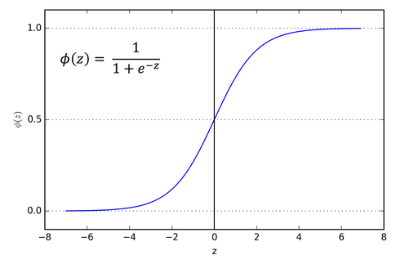
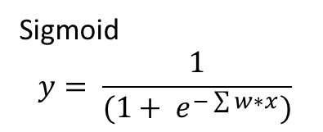
Better Activation function
If you want output in range of 0 to 1, use Sigmoid function as activation function
Sigmoid
$$y= \frac{1}{(1+ e^{−\sum{w∗x}})}$$

Slide 21
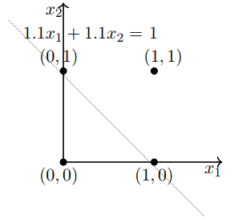
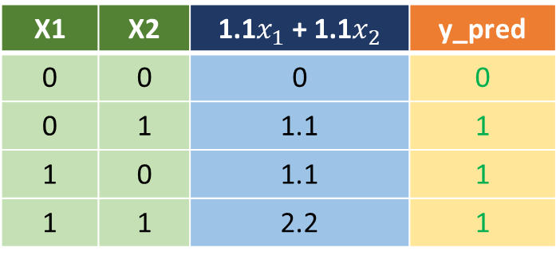
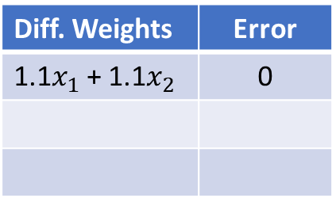

Boolean functions with Perceptron
Remember, the only addition in
MP Neuron model is the weights
Let’s implement the OR function
$$y=1 if w_{1}x_{1}+w_{2}x_{2}≥ θ$$
X1 | X2 | 1.1$x_{1}$ + 1.1$x_{2}$ | y_pred
0 | 0 | 0 | 0
0 | 1 | 1.1 | 1
1 | 0 | 1.1 | 1
1 | 1 | 2.2 | 1
Diff. Weights | Error
1.1$x_{1}$ + 1.1$x_{2}$ | 0

Slide 22
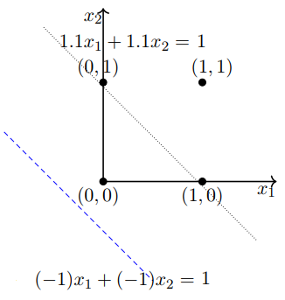
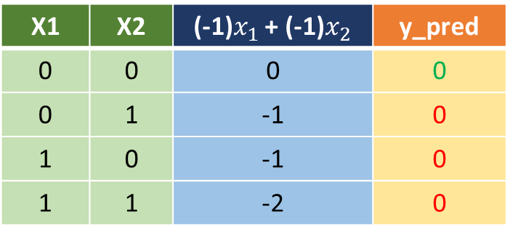
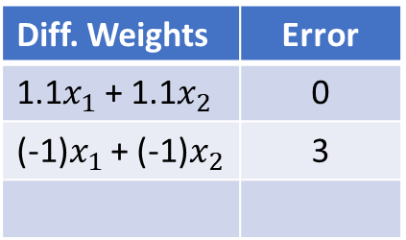
Boolean functions with Perceptron
Remember, the only addition in
MP Neuron model is the weights
Let’s implement the OR function
$$y=1 if w_{1}x_{1}+w_{2}x_{2}≥ θ$$
X1 | X2 | (-1)$x_{1}$ + (-1)$x_{2}$ | y_pred
0 | 0 | 0 | 0
0 | 1 | -1 | 0
1 | 0 | -1 | 0
1 | 1 | -2 | 0
Diff. Weights | Error
1.1$x_{1}$ + 1.1$x_{2}$ | 0
(-1)$x_{1}$ + (-1)$x_{2}$ | 3

Slide 23
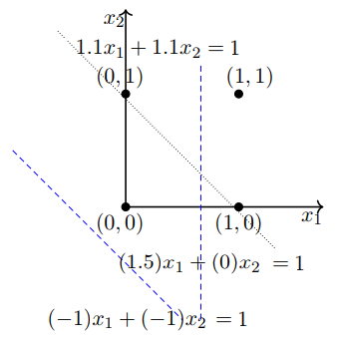
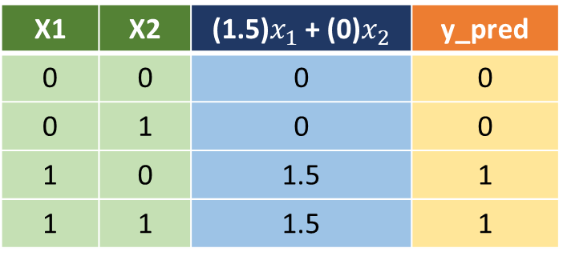
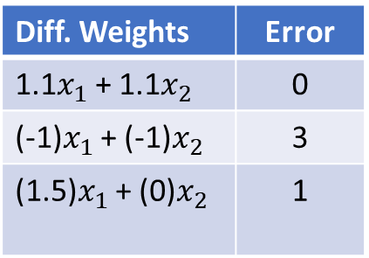
Boolean functions with Perceptron
Remember, the only addition in
MP Neuron model is the weights
Let’s implement the OR function
$$y=1 if w_{1}x_{1}+w_{2}x_{2}≥ θ$$
X1 | X2 | (1.5)$x_{1}$ + (0)$x_{2}$ | y_pred
0 | 0 | 0 | 0
0 | 1 | 0 | 0
1 | 0 | 1.5 | 1
1 | 1 | 1.5 | 1
Diff. Weights | Error
1.1$x_{1}$ + 1.1$x_{2}$ | 0
(-1)$x_{1}$ + (-1)$x_{2}$ | 3
(1.5)$x_{1}$ + (0)$x_{2}$ | 1

Slide 24
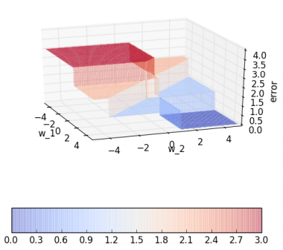
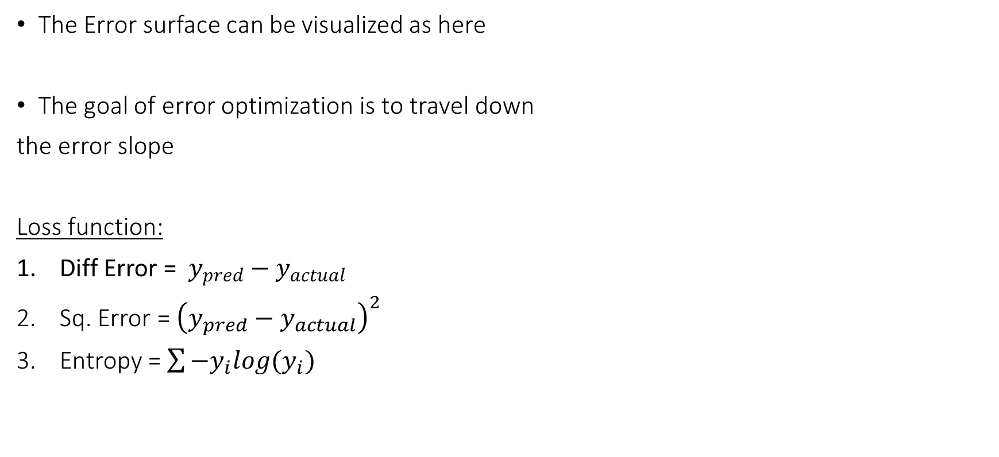
Error Surfaces
The Error surface can be visualized as here
The goal of error optimization is to travel down
the error slope
Loss function:
Diff Error = $y_{pred}−y_{actual}$
Sq. Error = ${\left(y_{pred}−y_{actual}\right)}^{2}$
Entropy = $\sum{−y_{i}log{(y}_{i})}$

Slide 25
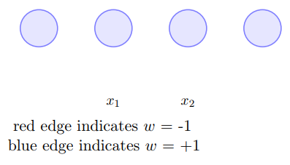
Multi-Layer Perceptron
Notes:
Sounds like a Autobot from Transformers

Slide 26
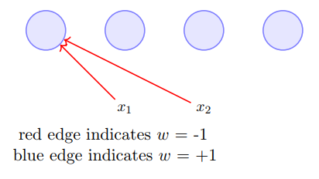
Multi-Layer Perceptron
Notes:
Sounds like a Autobot from Transformers

Slide 27
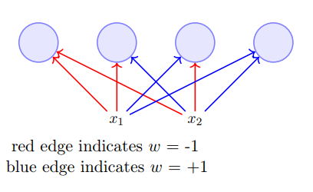
Multi-Layer Perceptron
Notes:
Sounds like a Autobot from Transformers

Slide 28
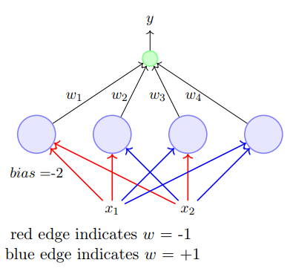
Multi-Layer Perceptron
The first layer is Input Layer
The last layer is Output Layer
There can be one or many hidden layers
I claim that this architecture can fit any Boolean function
Try it out!
Notes:
Sounds like a Autobot from Transformers

Slide 29
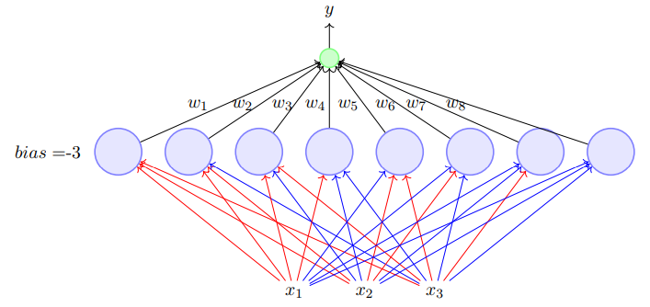
Multi-Layer Perceptron
Notes:
Sounds like a Autobot from Transformers

Slide 30
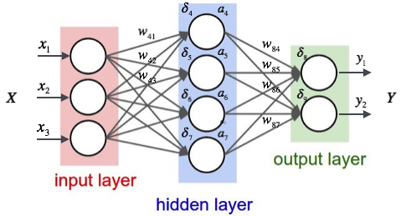
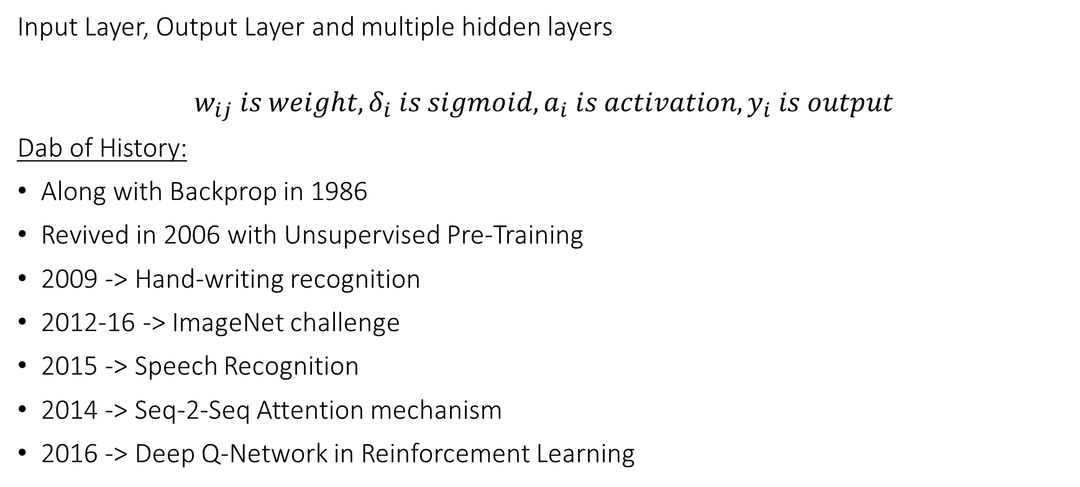
Neural Network
Input Layer, Output Layer and multiple hidden layers
$$w_{ij} is weight, δ_{i} is sigmoid, a_{i} is activation, y_{i} is output$$
Dab of History:
Along with Backprop in 1986
Revived in 2006 with Unsupervised Pre-Training
2009 -> Hand-writing recognition
2012-16 -> ImageNet challenge
2015 -> Speech Recognition
2014 -> Seq-2-Seq Attention mechanism
2016 -> Deep Q-Network in Reinforcement Learning

Slide 31
Back-Propagation

Slide 32

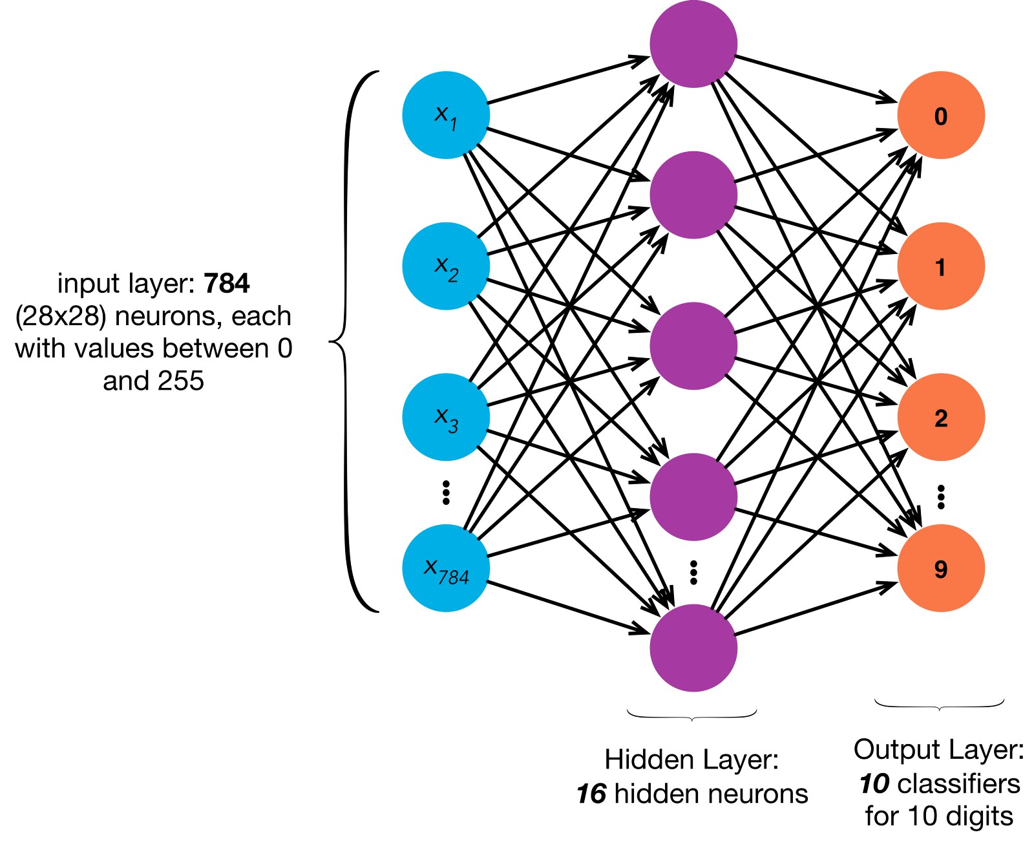
Demo time!

Slide 33

Thank you
Feedback much appreciated ☺
Please mention your BRID to receive a thank you
Presentation and code: https://github.com/ankushtale/
PyData November Meetup – Nov 25th

